Slide 1

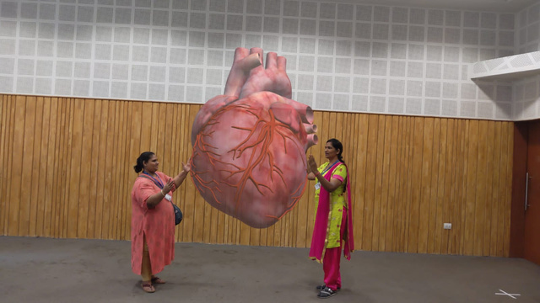

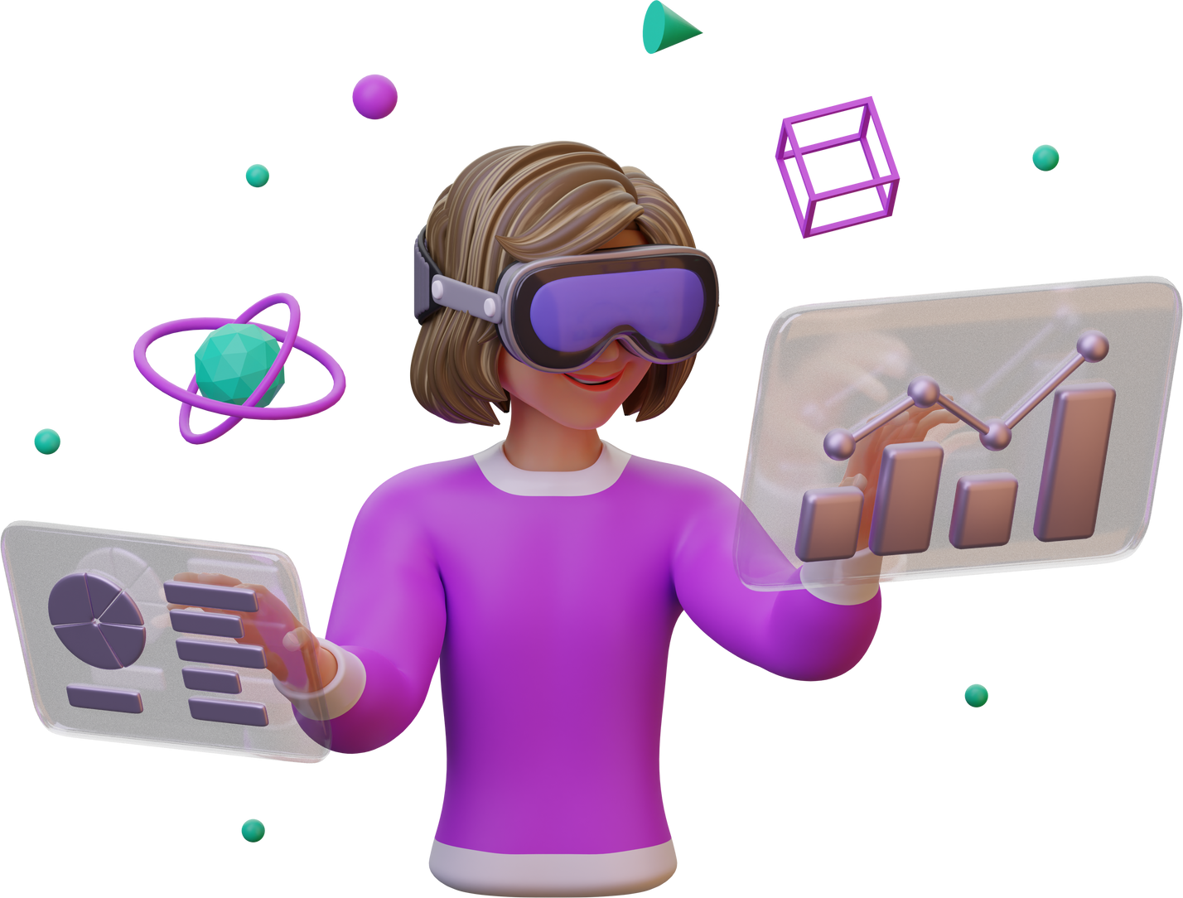
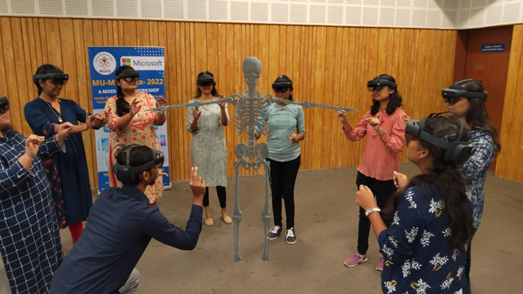
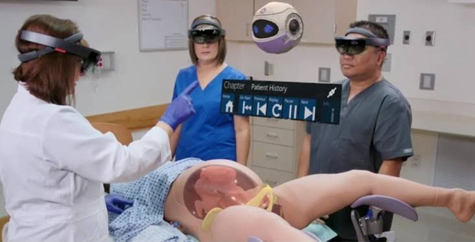
Digital Health Department and Digital Learning Studio
Teaching- Learning Platforms Such as AR-VR have brought a paradigm shift in the process of Learning and Understanding.
Augmented Teaching
Complex Topics Conveyed with 3D Interactive Models
Experiential Learning
Visualized Aided learning from anywhere: Remote Classrooms
Formative Assessment
Conduction of Remote Evaluation and Assessments

Slide 2
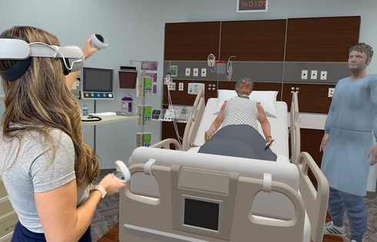
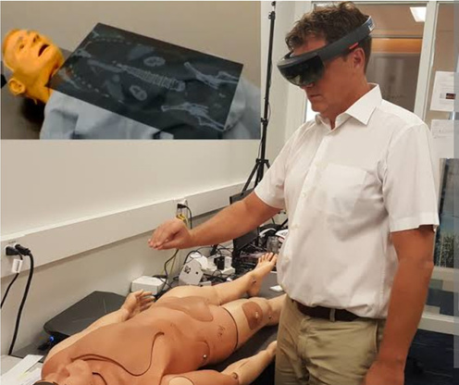
Digital Health Department and Digital Learning Studio
Expanding Horizons
Patient Care
Improved Patient Care through Simulated Training
Healthcare Diagnostics
Improved Diagnostics with ease of application
When Learning through AR-VR TL platform
75% Information Retention Rates and
275% Higher Confidence rates seen in Students

